Slide 1


Melek for Member #1
Marketing Analytics
By : Novaldy Pratama Putra

Slide 2


Hi ! My name is Aldy

Slide 3

Highlight
What is Marketing Analytics?
The Importance of Marketing Analytics
How Organizations Use Marketing Analytics
How to Start the Marketing Analytics Process
Example of Marketing Analytics (RFM)
Hands On

Slide 4

What is Marketing Analytics?
Marketing analytics is the practice of using data to evaluate the effectiveness and success of marketing activities. Marketing analytics allows you to gather deeper consumer insights, optimize your marketing objectives, and get a better return on investment.

Slide 5

The Importance of Marketing Analytics
In the modern marketing landscape, accurate data is more important than ever. Consumers have become highly selective in choosing the branded media they engage with and the media they ignore.
If brands want to catch the ideal buyer’s attention, they must rely on accurate data to create targeted personal ads based on individual interests, rather than broader demographic associations. This will allow marketing teams to serve the right ad, at the right time, on the right channel to move consumers down the sales funnel.

Slide 6
The Challenges of Data Analysis
The biggest challenge of the analysis process is understanding and utilizing the immense quantity of data marketers. This means that marketers must determine how to best organize the data into a digestible format to derive actionable insights.
Some of the biggest marketing analytics challenges faced today are:
Data Quantity
Data Quality
Lack of Data Scientists
Selecting Attribution Models
Correlating Data
Notes:
Data Quantity: Big data emerged during the digital age, enabling marketing teams to record every consumer click, impression and view. However this quantity of data is irrelevant if it cannot be structured and analyzed for insights that allow for in-campaign optimizations. This has left marketers grappling with how to best organize data to evaluate its meaning. In fact, research shows that experienced data scientists spend the majority of their time wrangling and formatting data, rather than analyzing it
Data Quality: Not only is there a problem in terms of the vast information organizations must sift through, but this data is often viewed as unreliable. According to Forrester, 21 percent of respondents’ media budgets were wasted due to poor data quality. This means one dollar out of every 5 dollars was not being utilized effectively. Over the course of a year, these dollars can add up, resulting in $1.2 million dollars and $16.5 million dollars of wasted budget for mid-size and enterprise level firms. Organizations need a process to maintain data quality, so that employees can leverage accurate information to make the right decisions.
Lack of Data Scientists: Even if companies have access to the right data, many don’t have access to the right people. In fact, according to a survey by The CMO, only 1.9% of companies believe they have the right people to fully leverage marketing analytics.
Selecting Attribution Models: Determining the model that provides the right insights can be tricky. For example, media mix modeling and multi-touch attribution offer entirely different insights – aggregate campaign-focused data and person-level consumer data respectively. The models that marketers choose will dictate the types of insights they receive. Engagement analysis across so many channels can create confusion when it’s time to choose the right model.
Correlating Data: In this same vein, because marketers are collecting data from so many different sources, they must find a way to normalize it to make it comparable. It’s especially challenging comparing online and offline engagements, as they are typically measured by different attribution models. This is where unified marketing measurement and marketing analytics platforms demonstrate true value, organizing data from disparate sources.

Slide 7
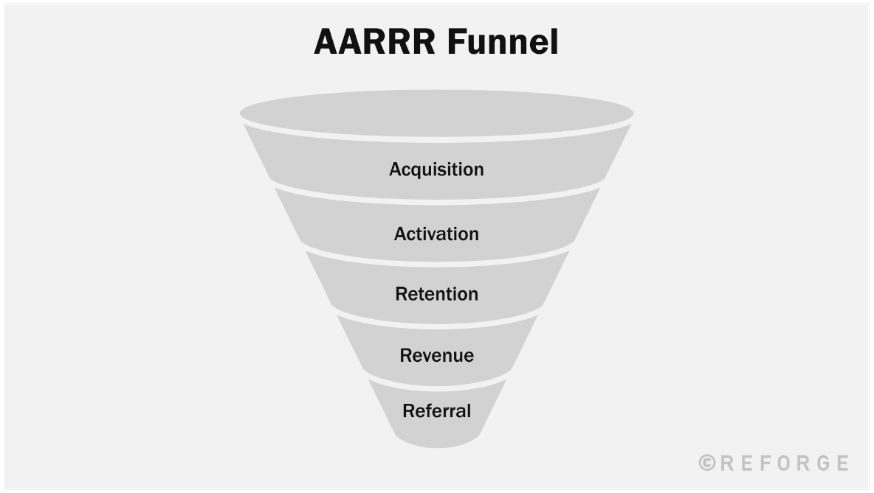

Slide 8
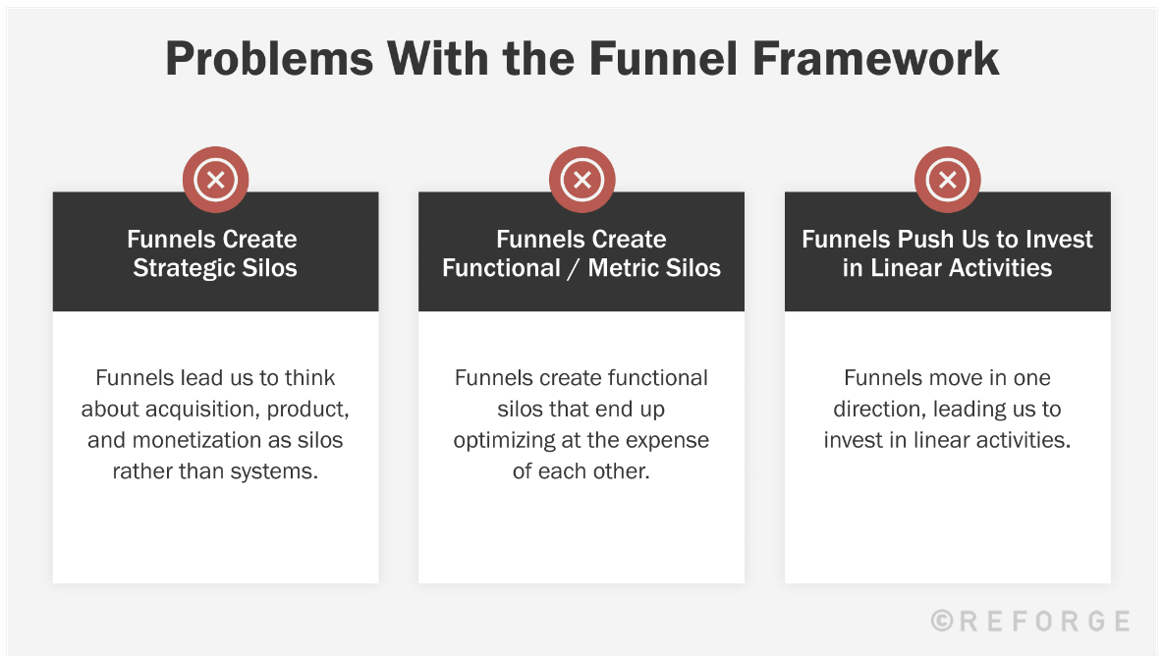

Slide 9
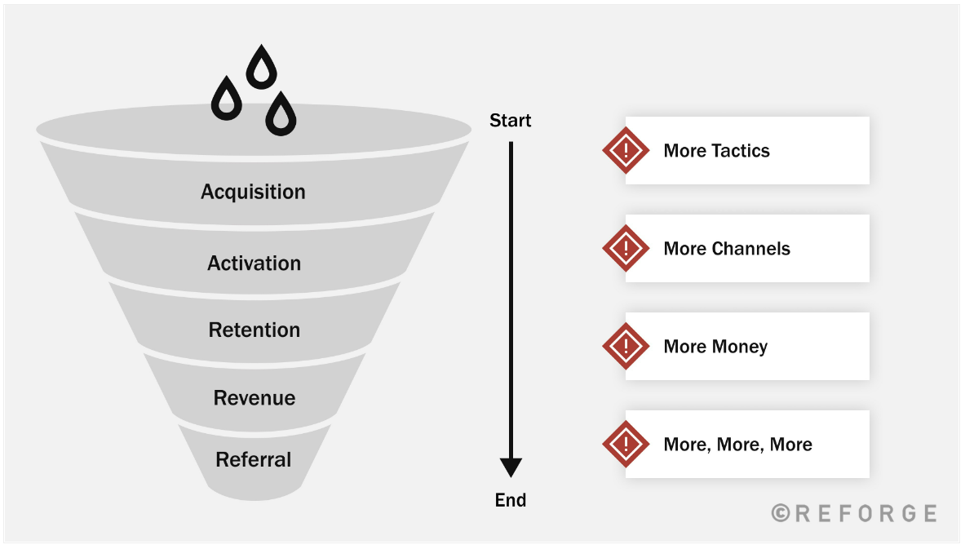

Slide 10
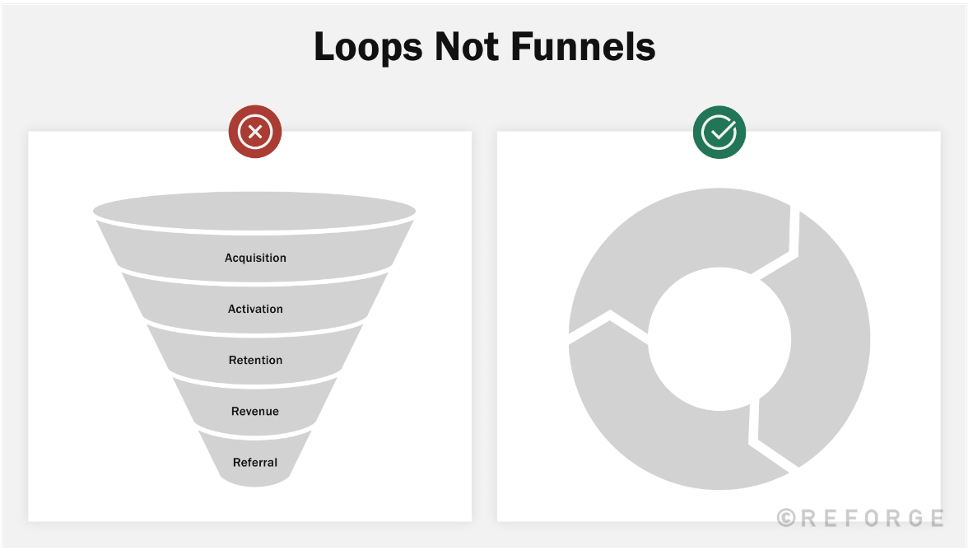

Slide 11
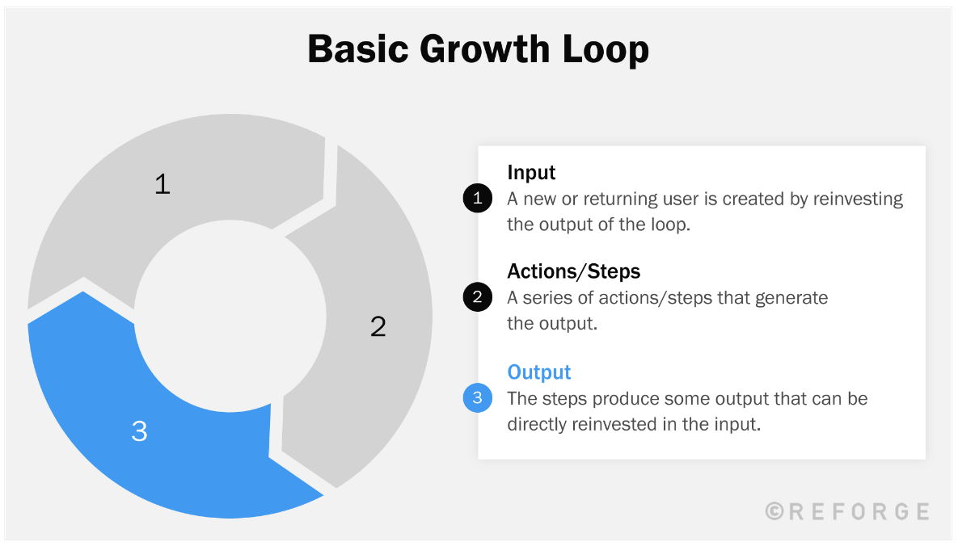

Slide 12
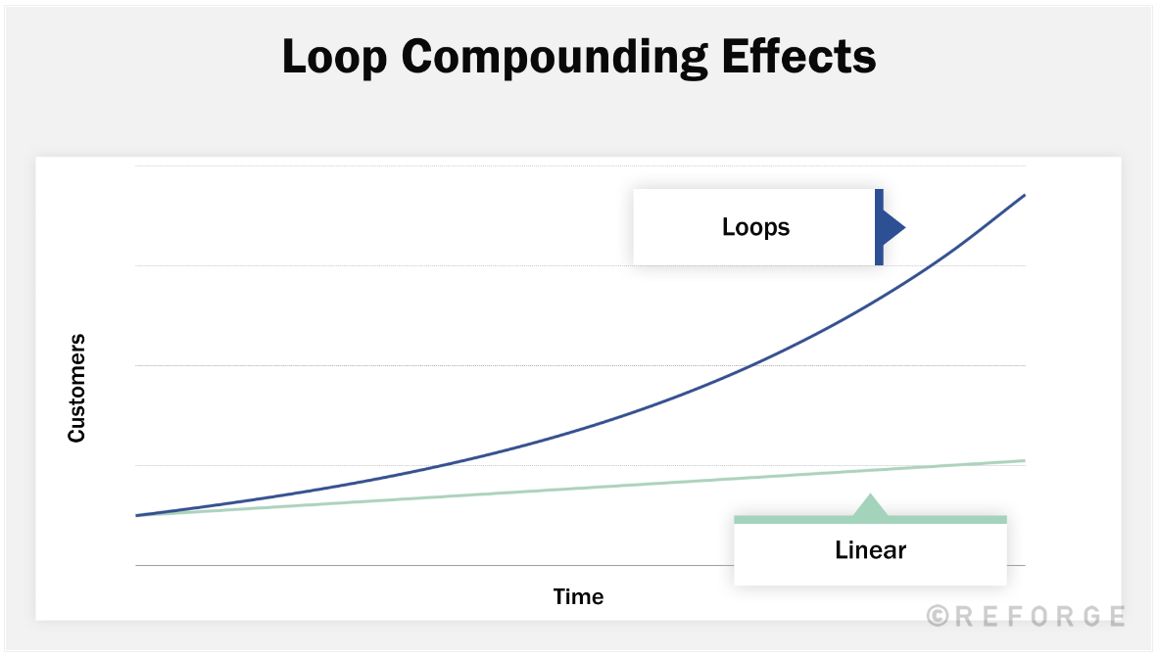

Slide 13
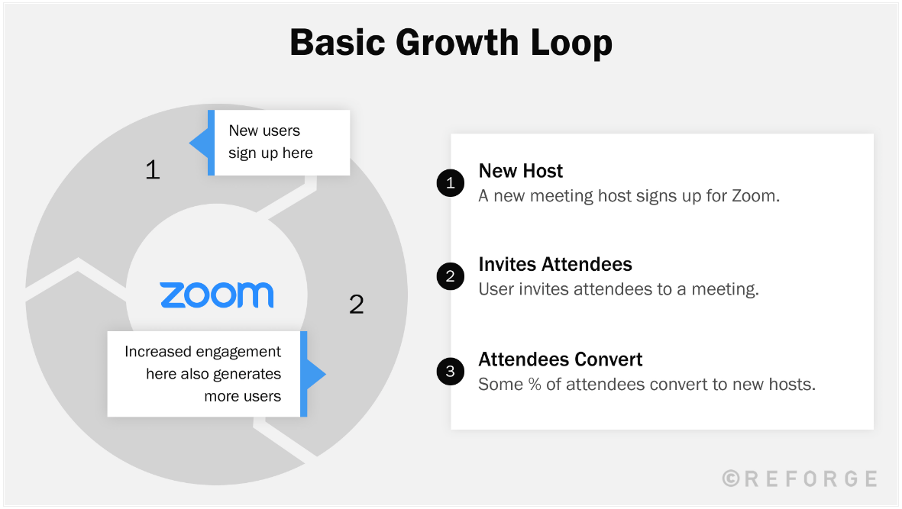

Slide 14
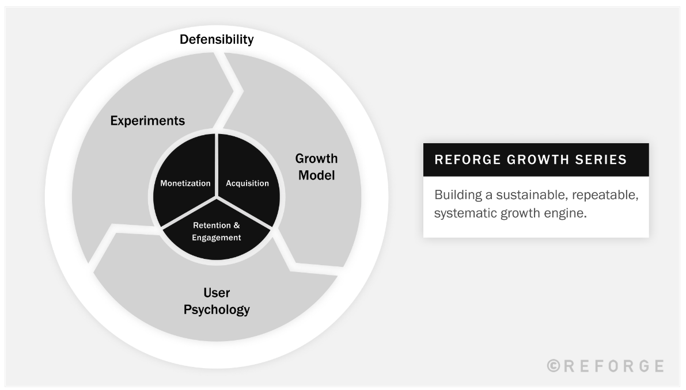

Slide 15
2. Retention

Slide 16
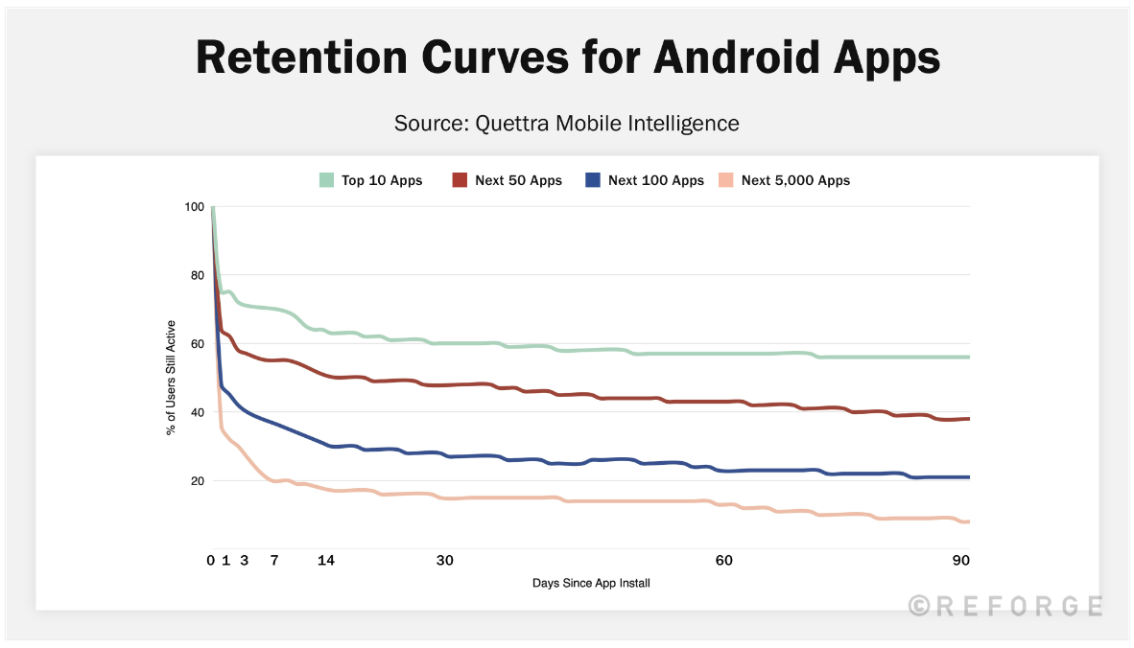

Slide 17
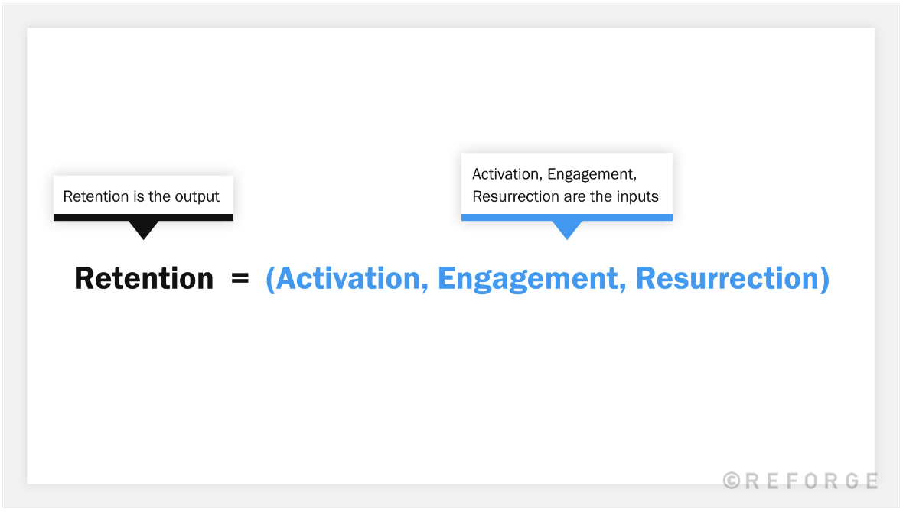

Slide 18
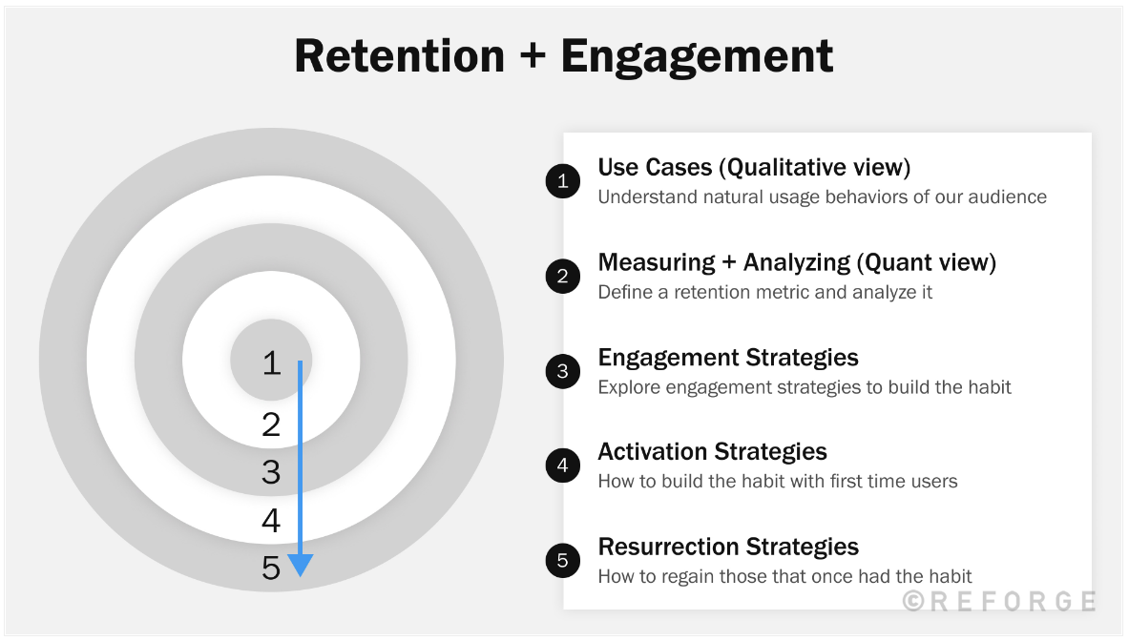

Slide 19
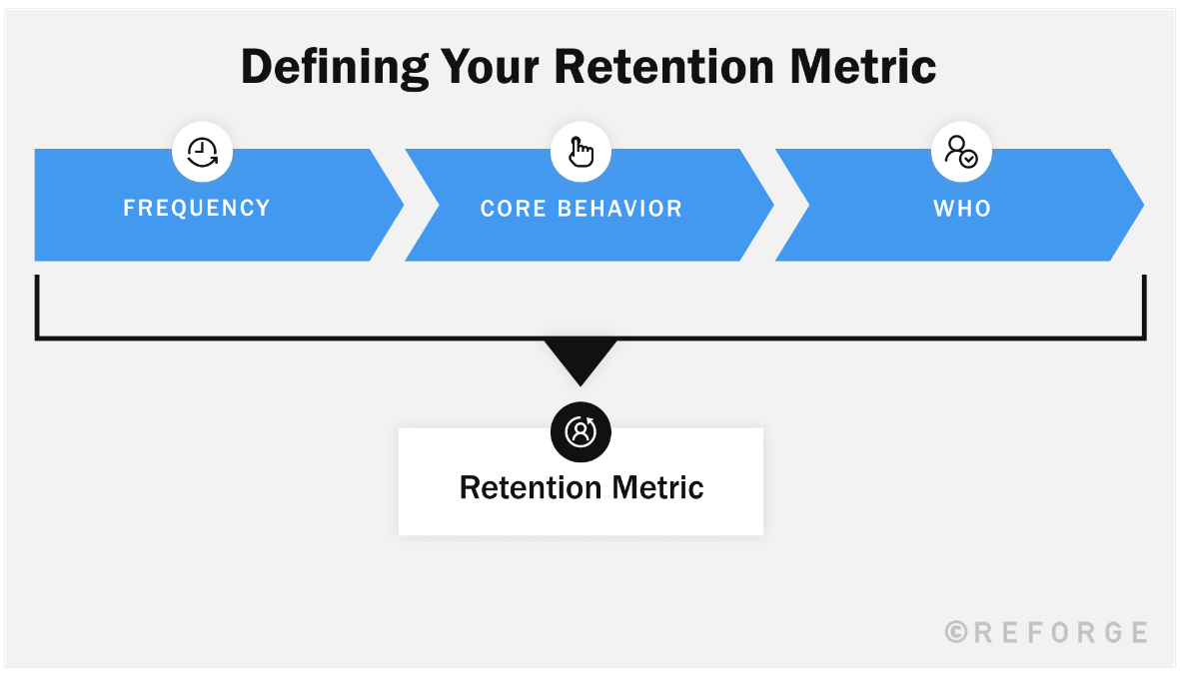

Slide 20
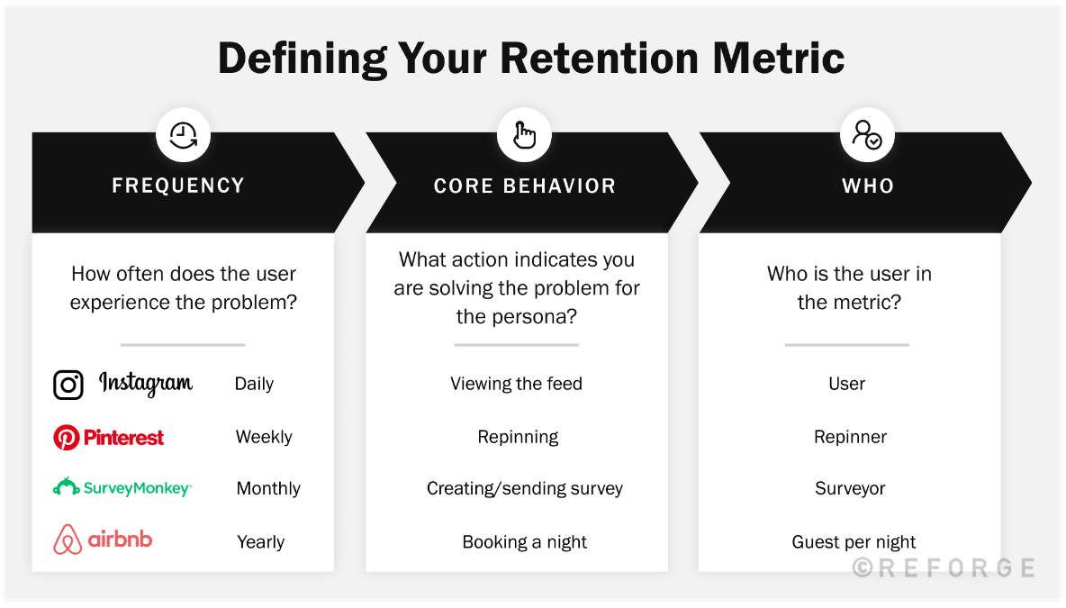

Slide 21
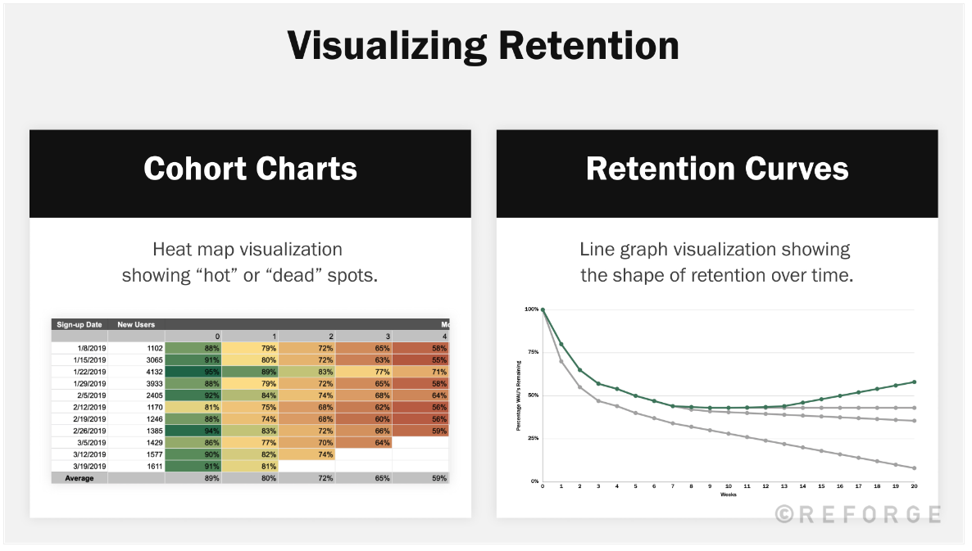

Slide 22
Example of Marketing Analytics (RFM)
RFM = Recency + Frequency + Monetary
RFM analysis ranks each user by considering the following factors:
Recency. Time since last order or last engaged with the product
Frequency. Total number of transactions or average time between transactions/engaged visits
Monetary. Total or average transaction value.tions/engaged visits

Slide 23
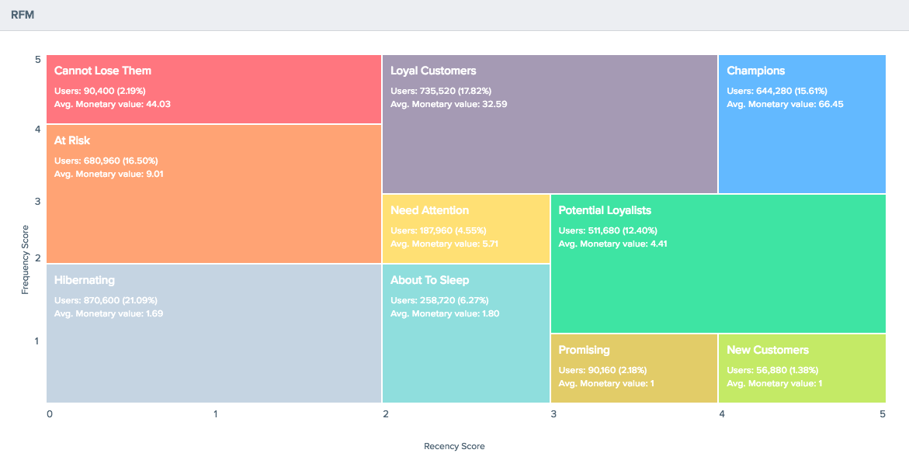
Example of Marketing Analytics (RFM)
Notes:
Let’s delve into few interesting segments:
Champions are your best customers, who bought most recently, most often, and are heavy spenders. Reward these customers. They can become early adopters for new products and will help promote your brand.
Potential Loyalists are your recent customers with average frequency and who spent a good amount. Offer membership or loyalty programs or recommend related products to upsell them and help them become your Loyalists or Champions.
New Customers are your customers who have a high overall RFM score but are not frequent shoppers. Start building relationships with these customers by providing onboarding support and special offers to increase their visits.
At Risk Customers are your customers who purchased often and spent big amounts, but haven’t purchased recently. Send them personalized reactivation campaigns to reconnect, and offer renewals and helpful products to encourage another purchase.
Can’t Lose Them are customers who used to visit and purchase quite often, but haven’t been visiting recently. Bring them back with relevant promotions, and run surveys to find out what went wrong and avoid losing them to a competitor.

